Slide 1
Seth & Ken’s Excellent Adventures (in Code Review)
AppSec Day Melbourne

Slide 2

Introductions - Seth
Once known as the “King of Cola”, he ruled the mighty Carbonators during the pre-century, west-coast Soda Wars. His rule was cut short when HFCS was outlawed by California and the sugar prohibition era began. He led the first manned mission to Mars via a hot air balloon. Without hot air. Or the balloon. He speaks 14 languages, 12 of them based on the science fiction show “Star Trek”, 1 he made up with his imaginary friend Sharzazzle, and really - really poor Ol’ Timey English.
@sethlaw

Slide 3

Introductions - Ken
Ginger
Securer of Code...really, all of the code.
Known to the underground beaver pelt collecting community as the Spinal Archinator, for his activism in rebuilding beaver dams in the Yukon territories using only his teeth, in true beaver form.
@cktricky

Slide 4


Slide 5

Overview
Repeat after me:
Reviewing code is excellent!
Finding vulnerabilities is excellent!

Slide 6
Philosophy
Increase the likelihood of success. Not “Find every bug imaginable”
Successful is defined as:
Focusing on what matters by taking a risk based approach
Comprehensive
Timely
Easily consumed, well drafted reporting
Detailed notes
Language Agnostic Principles
Learn how to be an expert in becoming an expert
We’re here to learn a repeatable systematic approach to finding bugs
But with understanding that you may later choose to tweak this approach to suit you
Notes:
There are certainly language and technology specific vulnerabilities and solutions - for example - nosql injection with Mongo or Metaprogramming issues in Rails, but there are principles that can be used in terms of language agnostic approaches. We want to cover the language / framework specific stuff but tie it back to an approach principle

Slide 7
What to Expect
Our Experience and Stories
Specific Information about Code Reviews
Interactive Hands-On Exercises
Practice, practice, practice

Slide 8
The Circle-K Framework
Open a file, take notes :-)
Get to know the application purpose
Map the application
Brainstorm risks to the application
Build your list of review items
Perform all reviews
Double back

Slide 9

Let’s talk about approach
Notes:
This is where we are bummers and

Slide 10
Let’s talk about approach
Several types of reviews:
You decide how much time you spend on the review (Utopia, Ken lives there)
You have no time at all (Seth lives here)
Consulting middleground where you have a set time and scoped (hopefully) well or at least semi “okay”
NONE OF THESE TYPES MEAN “RUN A SCANNER AND ANALYZE THE RESULTS”

Slide 11
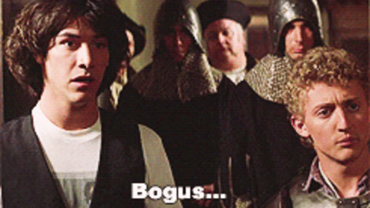
Let’s talk about approach

Slide 12
First, let’s talk about what we’re doing here
This course is intended to do the following, at a high level:
Show you where to look - Source to Sink
Show you what to look for, examples:
AuthZ/AuthN
Vulns specific to the type of app
General/OWASP AppSec vulns
Show where automation fits in the source code review process
Show some validation and remediation of the issues

Slide 13
Also, let’s talk about what we aren’t doing
This course is not intended to:
Teach you what the OWASP Top 10 are
Review web vulnerabilities
Cover all techniques for finding vulnerabilities in running applications
Be a primer on building secure applications
Cover all the ways that vulnerabilities manifest in code.

Slide 14
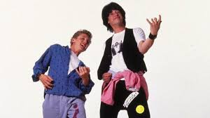
Tools/Lab Setup
Virtual Machine Setup/Installation (Virtualbox || VMWare)
Tool and environment familiarization

Slide 15
OWASP
How does the OWASP Top 10 relate?
What resources does OWASP provide?
How does this course differ from the OWASP Code Review Methodology?

Slide 16
Code Review Methodology
Overview

Slide 17
Introduction to the Methodology
Application Overview & Risk Assessment
Information Gathering
Authorization Review
Authentication Review
Auditing Review
Injection Review
Cryptographic Review
Configuration Review
Reporting

Slide 18
General Code Review Principles
Give yourself adequate time
Work in small chunks
Stay on task with current objective
Don’t make it personal
Ask questions
Framework/Code documentation is your friend
Build the code
Run the tests

Slide 19

Focus on what’s important
What happens when you run into 2 million lines of code?
And only have two weeks to look at it?
We will talk more about this...

Slide 20
Application Overview & Risk Assessment

Slide 21
Application Overview & Risk Assessment
We need to build a portrait of the application
Behavior Profile
Technology Stack
App Archeology

Slide 22
Application Overview & Risk Assessment
Behavior Profiling:
What does it do? (business purpose)
Who does it do this for? (internal / external customer base)
What kind of information will it hold?
What are the different types of roles?
What aspects concern your client/customer/staff the most?
Notes:
Think of yourself as an FBI profiler but instead of serial killers… its apps and their developers

Slide 23
Application Overview & Risk Assessment
Technology Stack:
Framework & Language - Rails/Ruby, Django/Python, mux/Golang
3rd party components, Examples:
Billing libraries (rubygem, npm, jar, etc.)
JavaScript widgets - (marketing tracking, sales chat widget)
Reliant upon other applications - such as receiving webhook events
Datastore - Postgresql, MySQL, Memcache, Redis, Mongodb, etc.

Slide 24
Application Overview & Risk Assessment
App Archeology
Look at the documentation. Examples:
Using SSO? SAML/OAuth?
What third-party elements does communicate with? (eg: external reporting, billing)
Custom authentication schemas - for instance - different auth for API versus web interface
Git allows you to do a little spelunking
Unit Tests
Learn about the data endpoints expect to receive
Learn about expected behavior
Often can find the way to form/craft a request

Slide 25
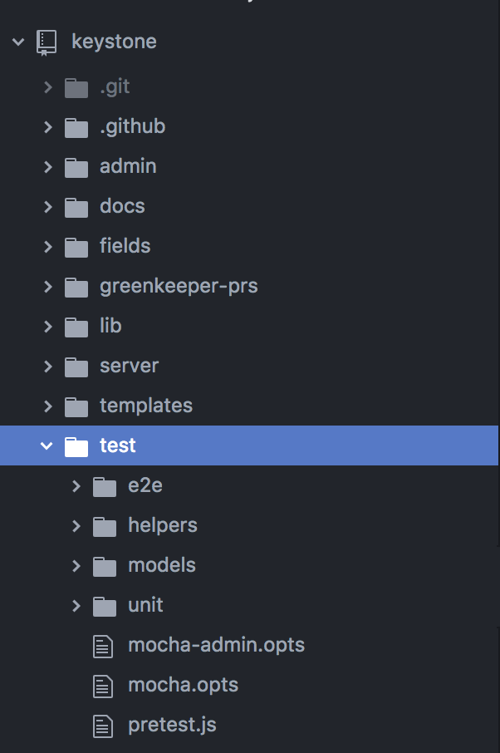
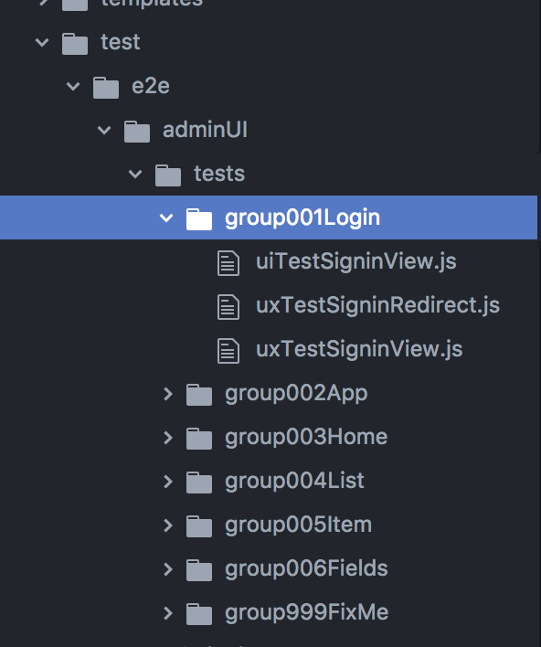
Application Overview & Risk Assessment
https://github.com/keystonejs/keystone

Slide 26
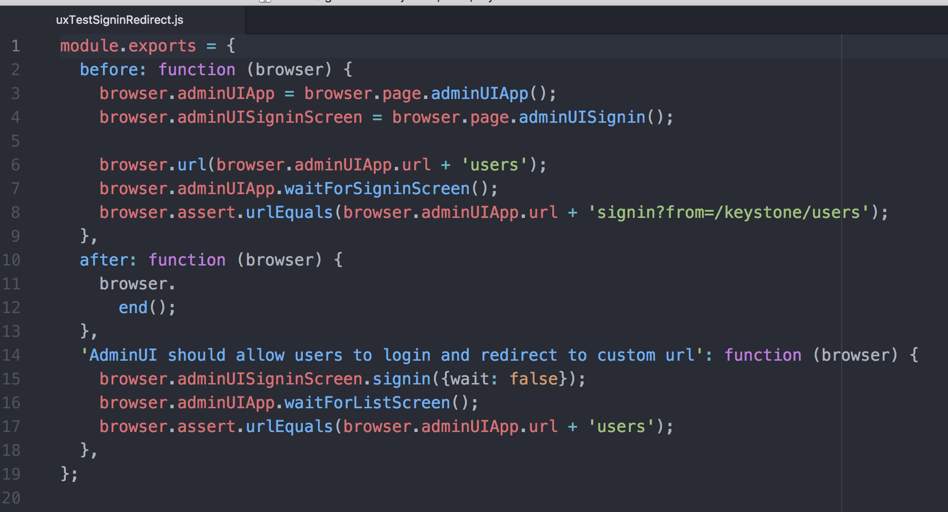
Application Overview & Risk Assessment

Slide 27
NOTE-TAKING

Slide 28
NOTE TAKING
Format I typically use
Commit # if I have it
Two sections
Actual Findings
Notes from the review
Actual finding gets filled out at the end
Description / Recommendation
Optional (or not) - Impact/Risk
Includes links to the code in question and/or screenshots
If applicable, reproduction steps but that might not be possible if purely static
Avoid emotive words
Notes from the review include (at a minimum)
Route mapping
“Threat model” details (really, rambling thoughts about what could go wrong”
PAIR WITH OTHERS!!!
Checklist of items you’ve checked for based on your threat model but also your normal “things” you should look at

Slide 29
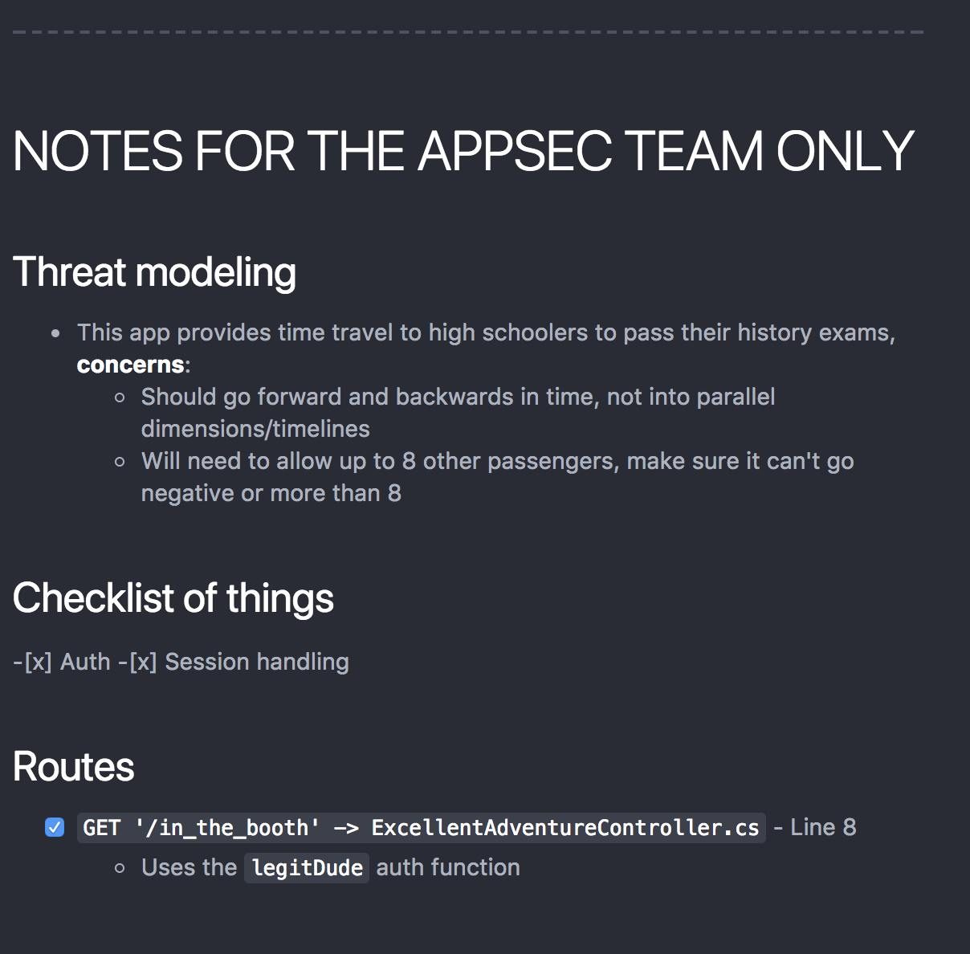
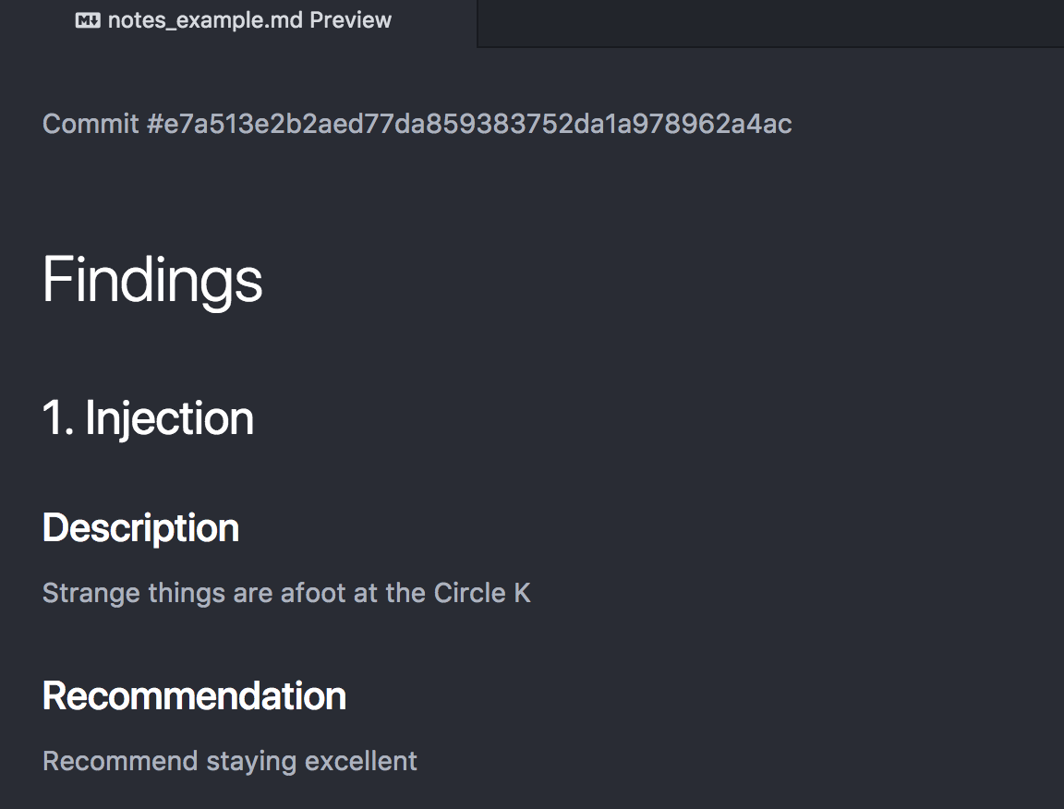
NOTE TAKING - SAMPLE

Slide 30

Application Overview & Risk Assessment
Open up the Keystone app, be able to answer:
Tech stack
Business purpose
Anything else you can dig up?
Exercise Napoleon
Notes:
Review Keystone and Take Notes about its purpose

Slide 31
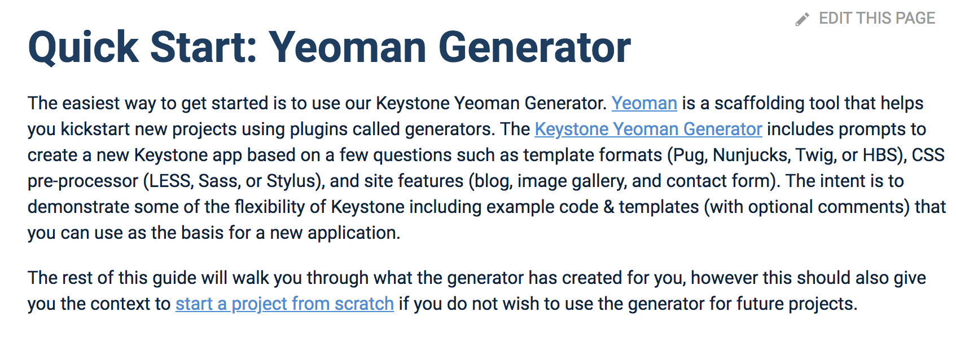
Napolean Exercise - Post-Mortem
At a minimum, these items were of note:
Tech Stack:
Node.js application
Using Express
Leveraging MongoDB, using Mongoose as the ORM
Business Purpose
Content Management Software
Documentation
https://keystonejs.com - Routes, Model schemas, Template lang can all be customized
Yeoman generator describes some of the tech options used

Slide 32

Napolean Exercise - Post-Mortem
Other security important parts of the app:
Authentication and Session Management - lib/session.js
The security folder :-)
CSRF implementation
X-Frame-Options / frameguard
IP Blocking
Admin folder
You learn React is used
Logic for admin signins admin/server/api/session/signin.js

Slide 33
Information Gathering

Slide 34

Information Gathering
THE MOST IMPORTANT THING IS TO UNDERSTAND THE APP

Slide 35
Information Gathering
Create a map (Mapping)
Identify endpoints, typical examples:
Rails = config/routes.rb
Django= urls.py
Node.js = index.js (and a whole bunch of others)
Java Spring = *Controller.java (Search for *Mapping)
.Net Core = *Controller.cs (Search for Routeprefix and Route)
Endpoints typically have at least three qualities
Authorization Filter
Logic processing
Datastore access

Slide 36
Information Gathering
Review authorization filters/decorators
How do we identify the user? eg: Session, Token, Basic Auth
What is the purpose? Authenticated users, Role check, or something else?
Identify what could go wrong
User-supplied parameters (IDOR)
CSRF… bet you didn’t see that coming! :-)
Story time… .NET & Response.Redirect("Login.aspx", false);
Client-side cookies, JWTs etc. (just general wonkiness in persistence)

Slide 37
Mapping

Slide 38
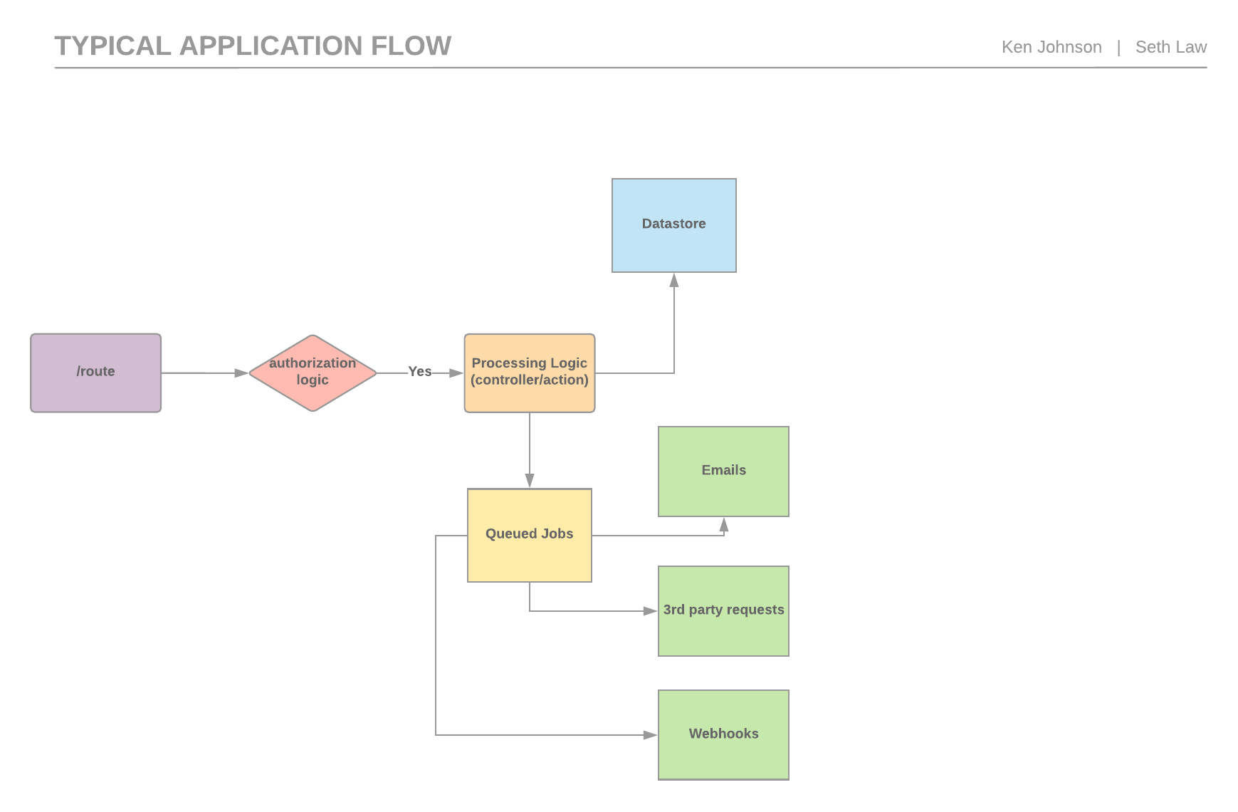

Slide 39
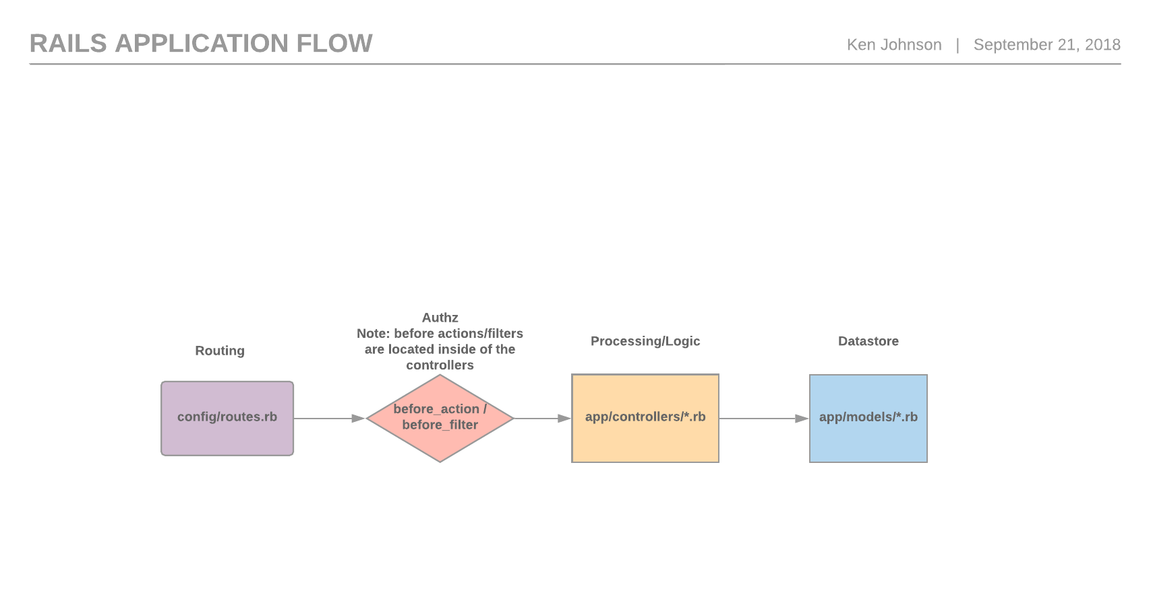

Slide 40
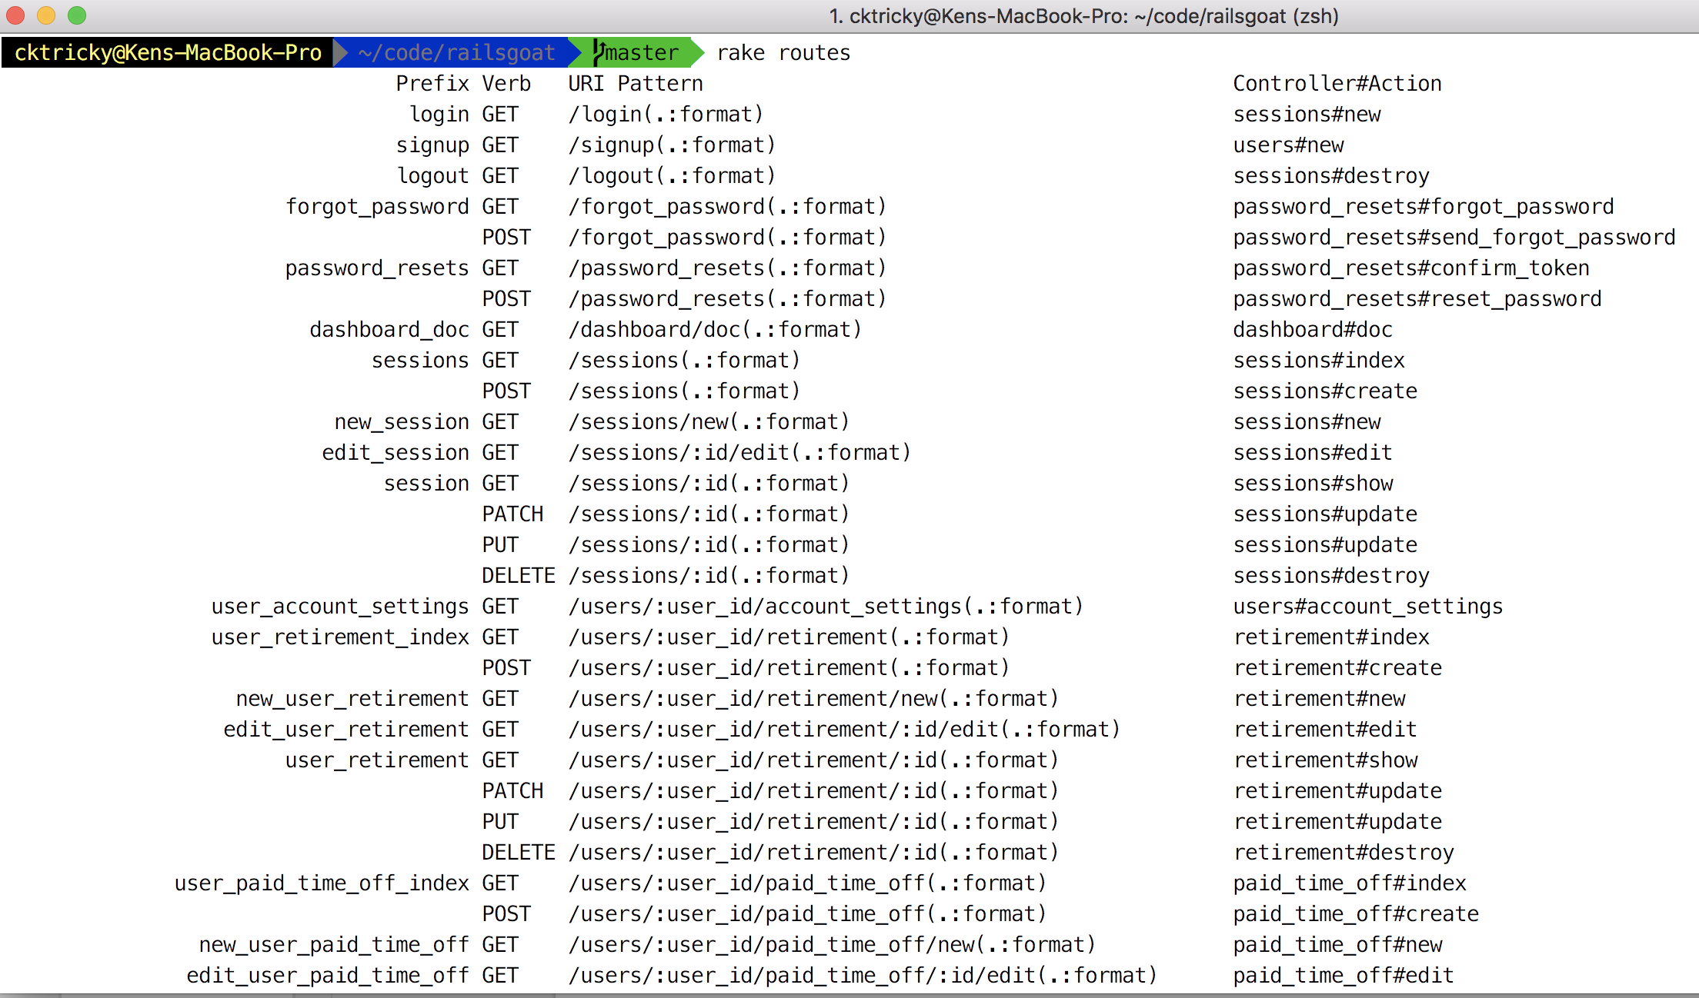
Rails - Map
Run “rake routes” if you can!

Slide 41
Rails - Map
Four parts
Path name (eg: forgot_password_path)
HTTP Verb (eg: GET)
HTTP Path (eg(s): forgot_password, forgot_password.json, forgot_password.xml)
Controller and Action (eg: Controller = password_resets, Action = forgot_password)

Slide 42
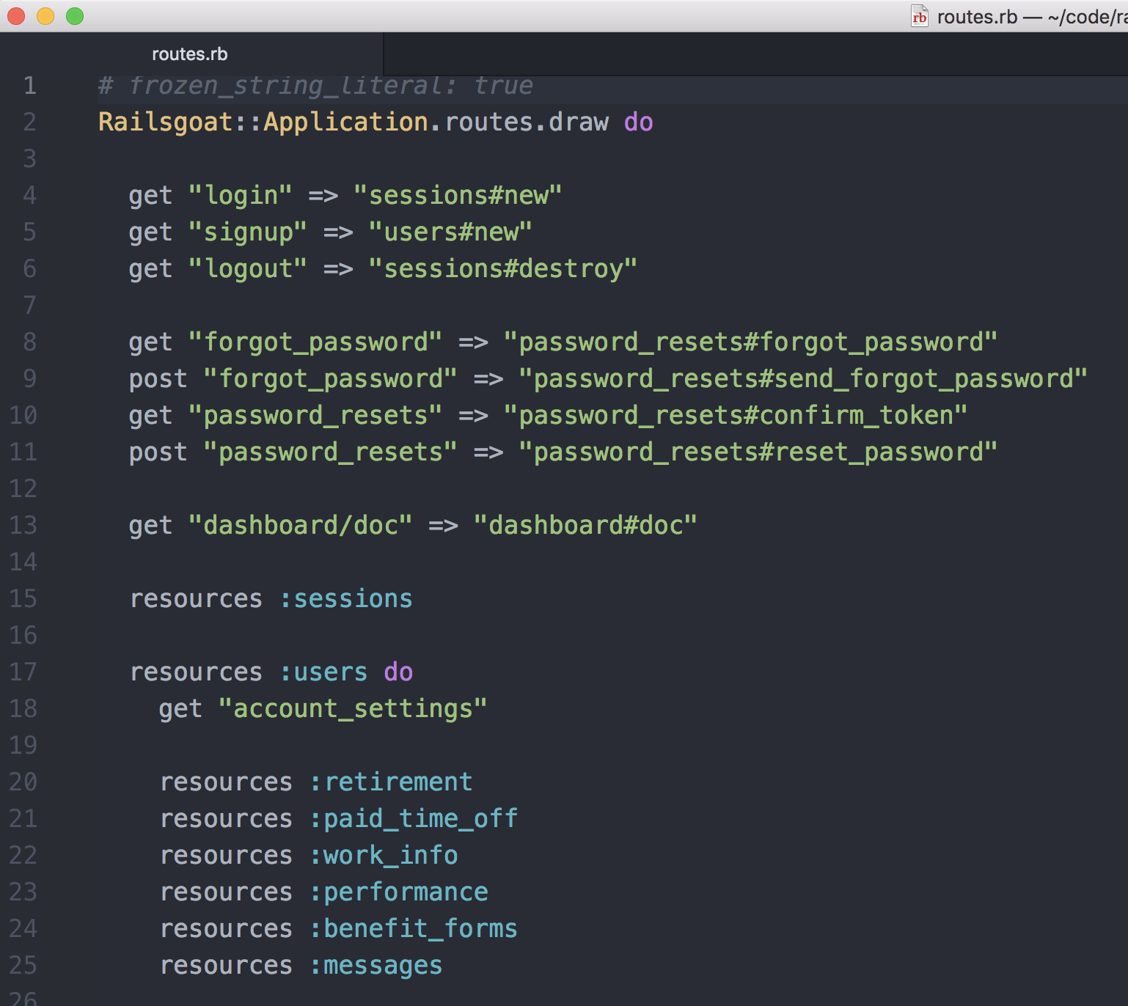
Rails - Map
If you cannot run rake routes, you’ll have to review the config/routes.rb file:

Slide 43
Rails - Routing Weirdness Alert
What do PUT, PATCH, DELETE, and POST all have in common?
That’s right, they are all POST requests
Rails uses the _method parameter to determine what kind of request it is

Slide 44
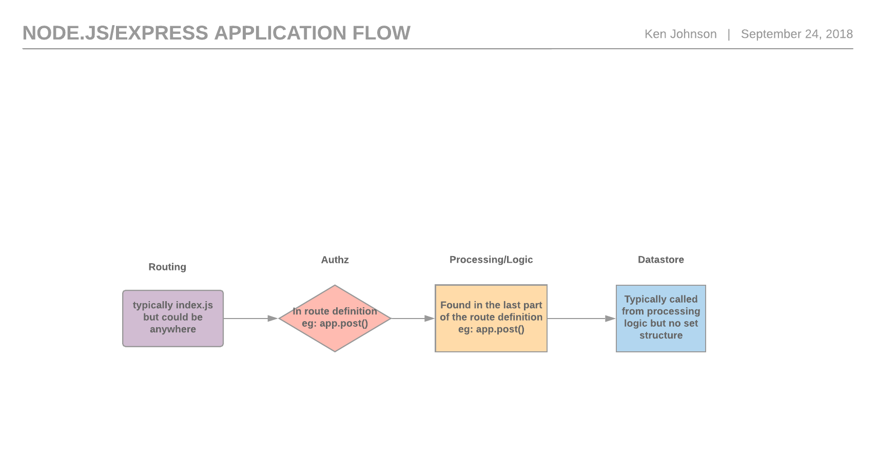

Slide 45
Node.js/Express - Map
My formula has been super basic, searching for:
app.get
app.post
app.delete
I always like to also annotate which of these is actually using middleware
We’ll create a checklist from this for tracing

Slide 46
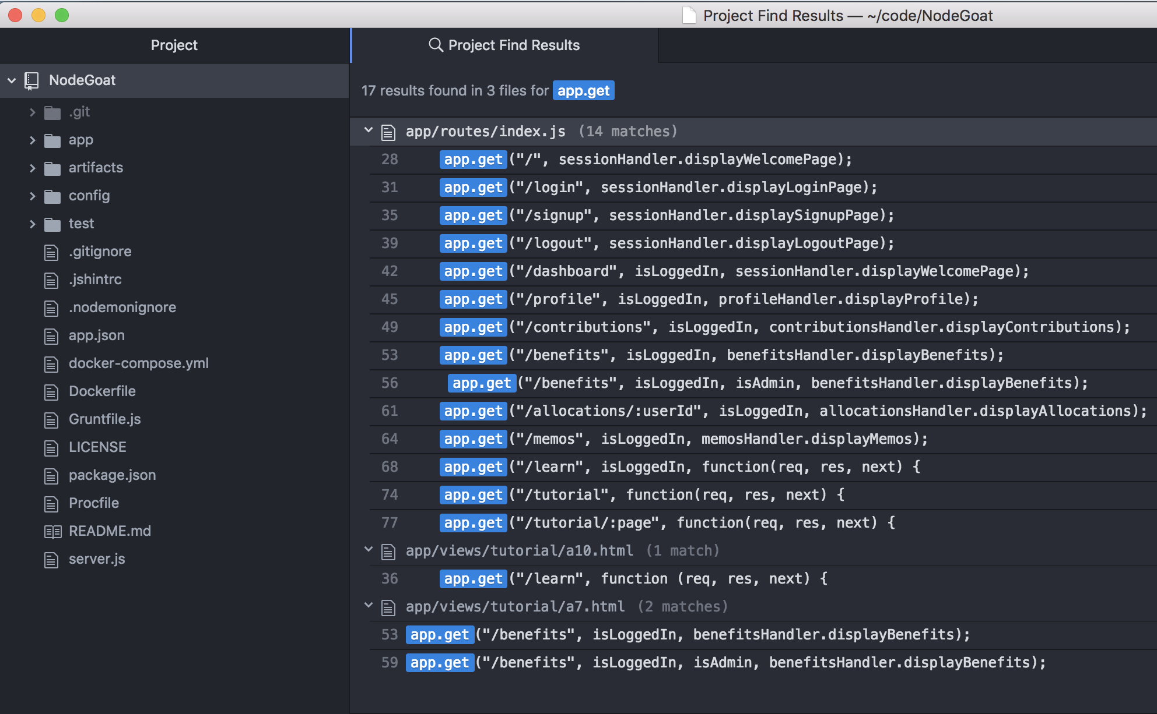
Node.js/Express - Map
Here is an example from Nodegoat, I downloaded it, and searched for app.get

Slide 47
Node.js/Express - Map
Take a close looksie

Slide 48
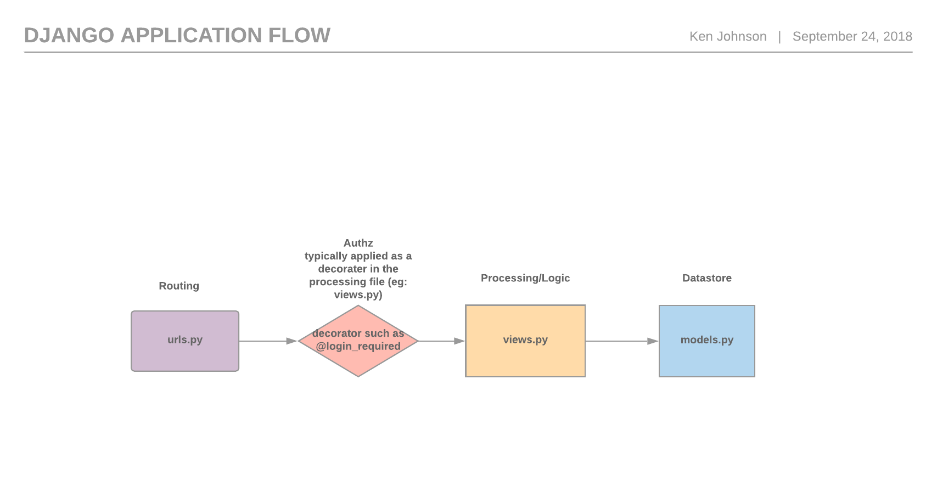

Slide 49
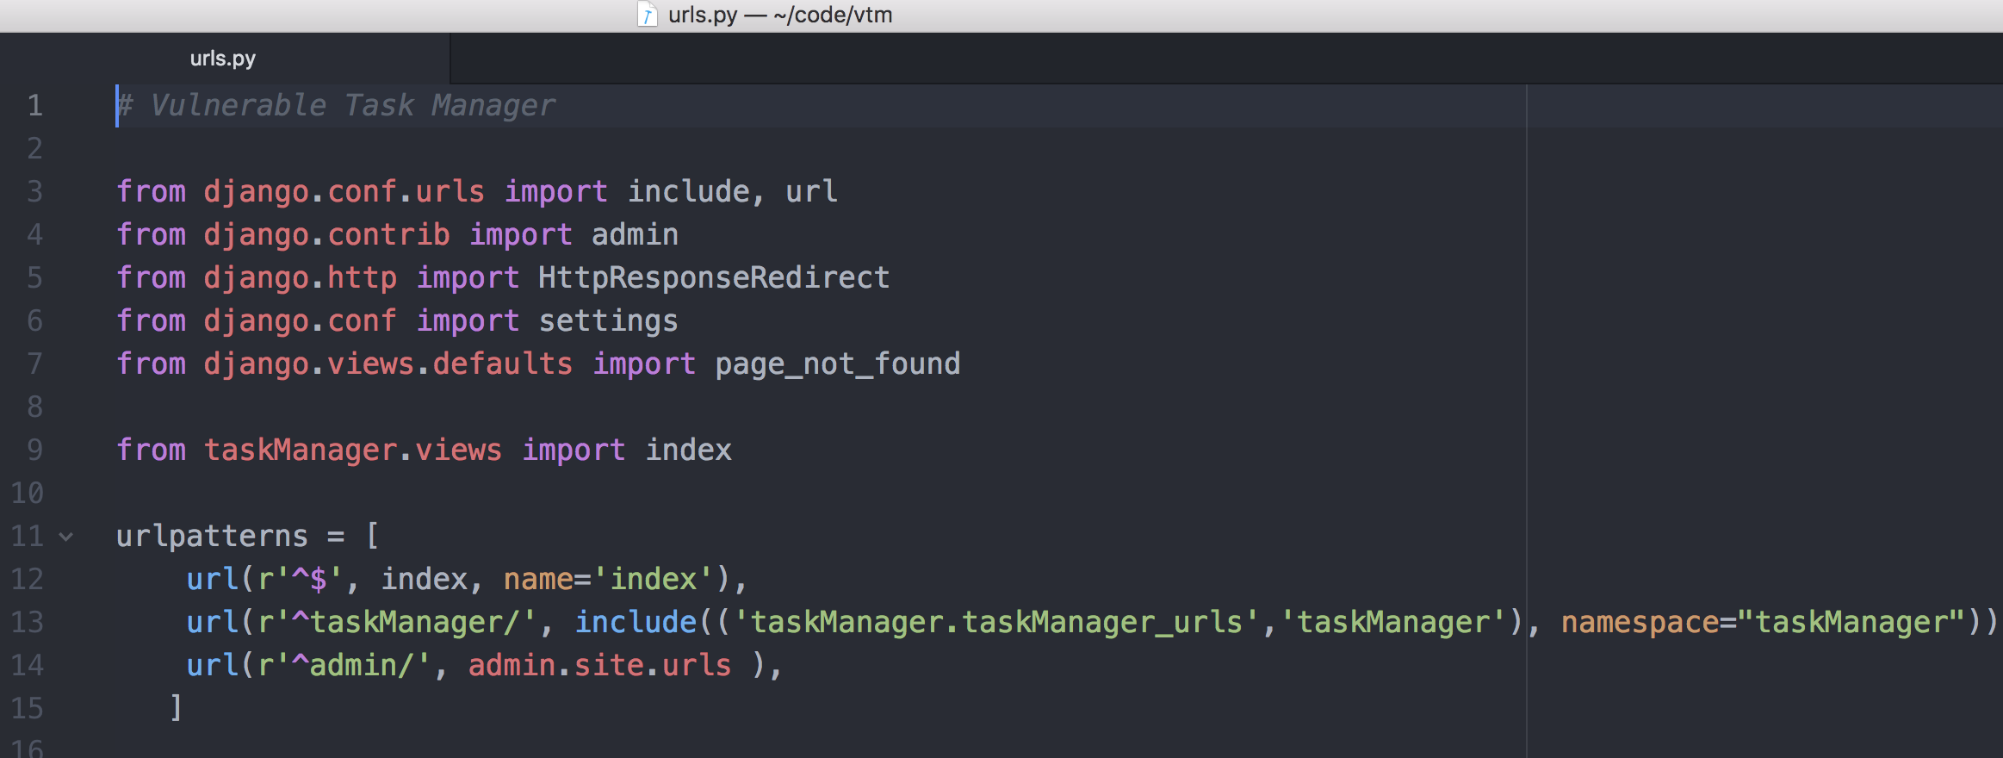
Django - Map

Slide 50
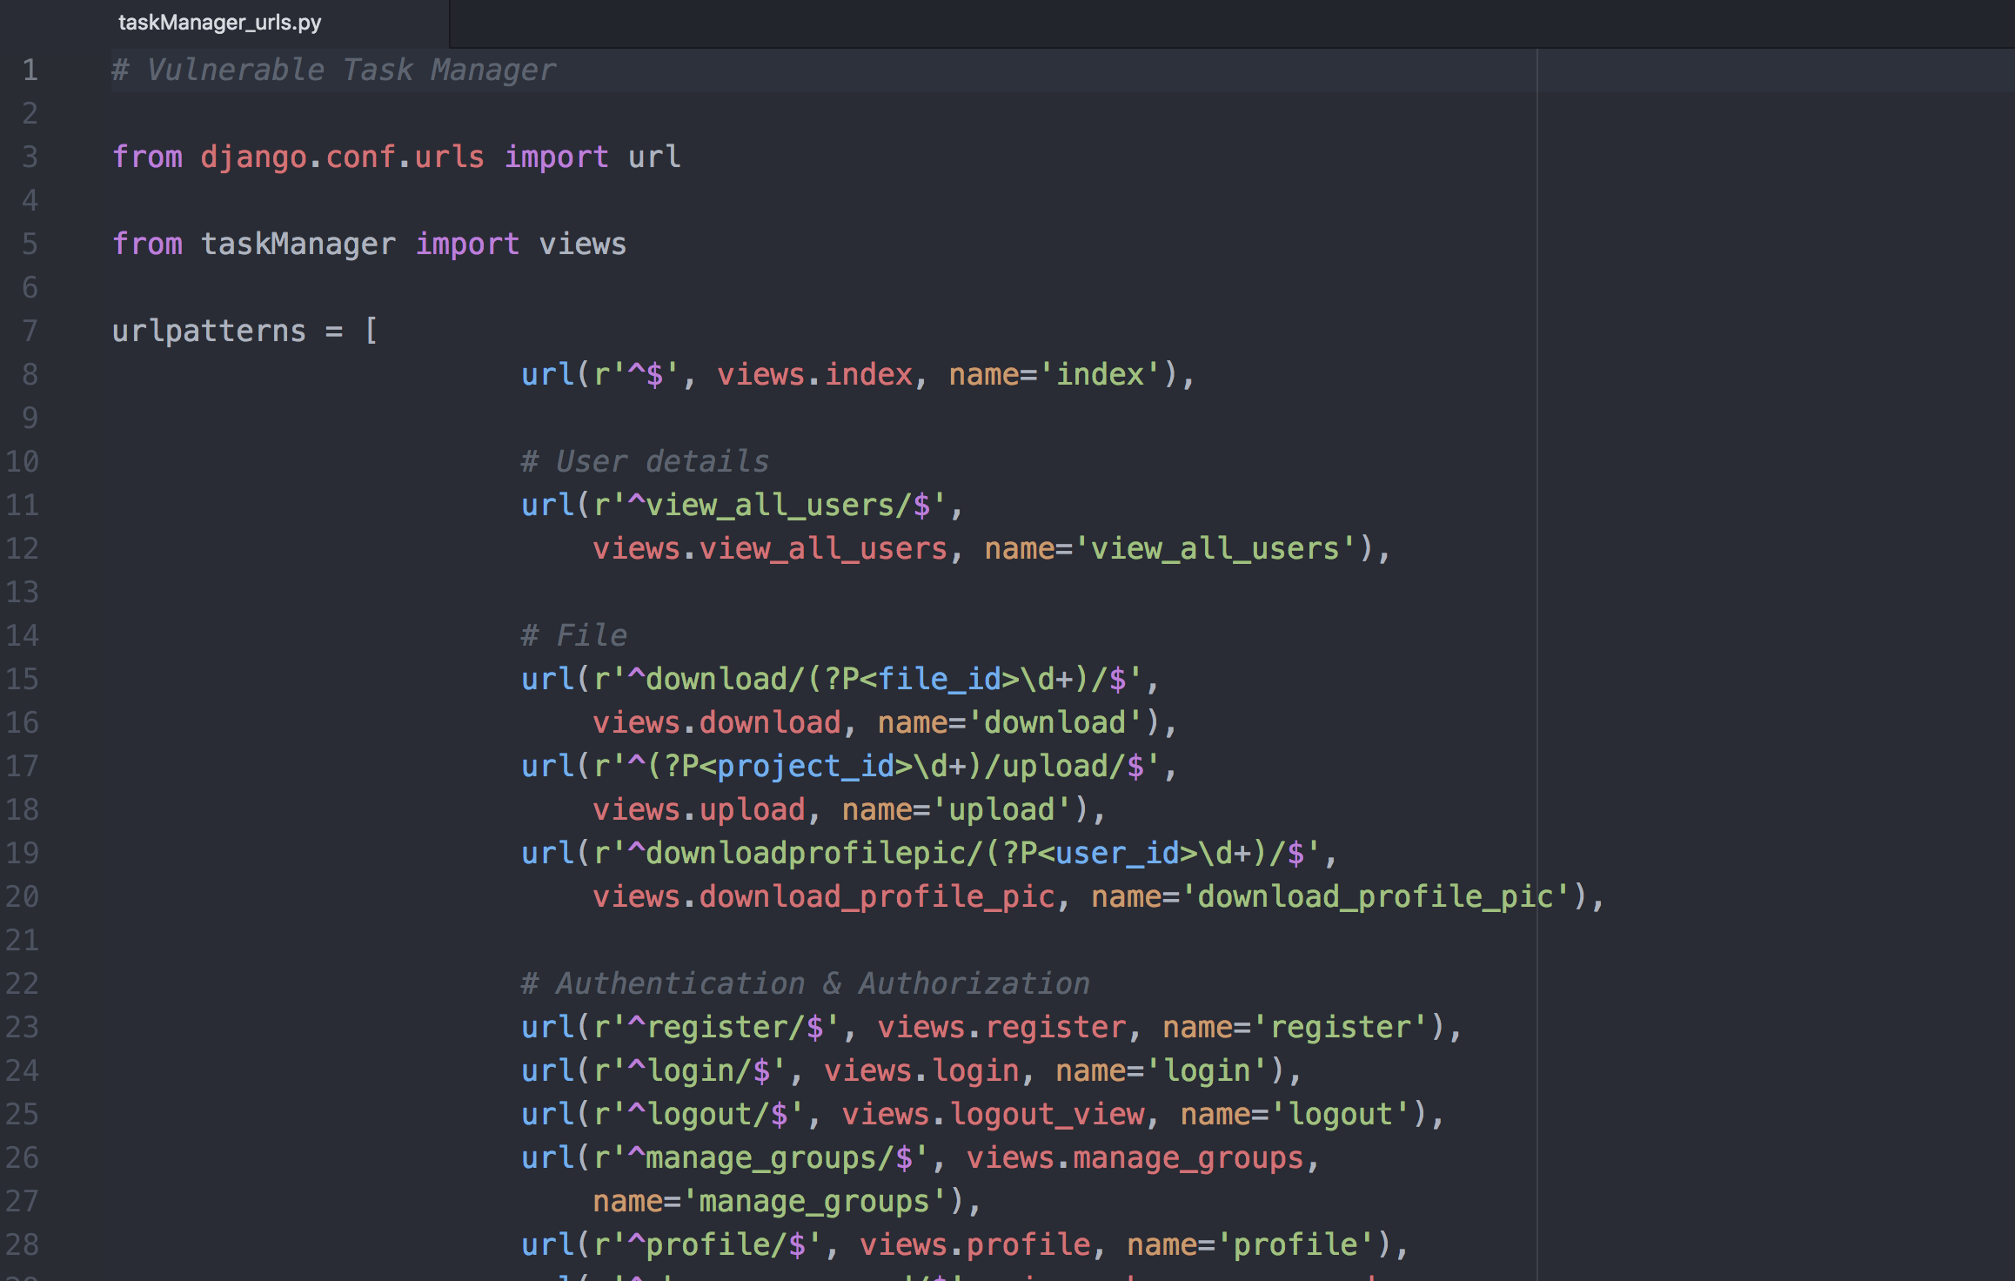
Django - Map

Slide 51
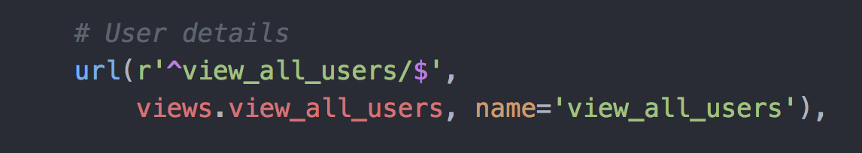
Django - Map

Slide 52
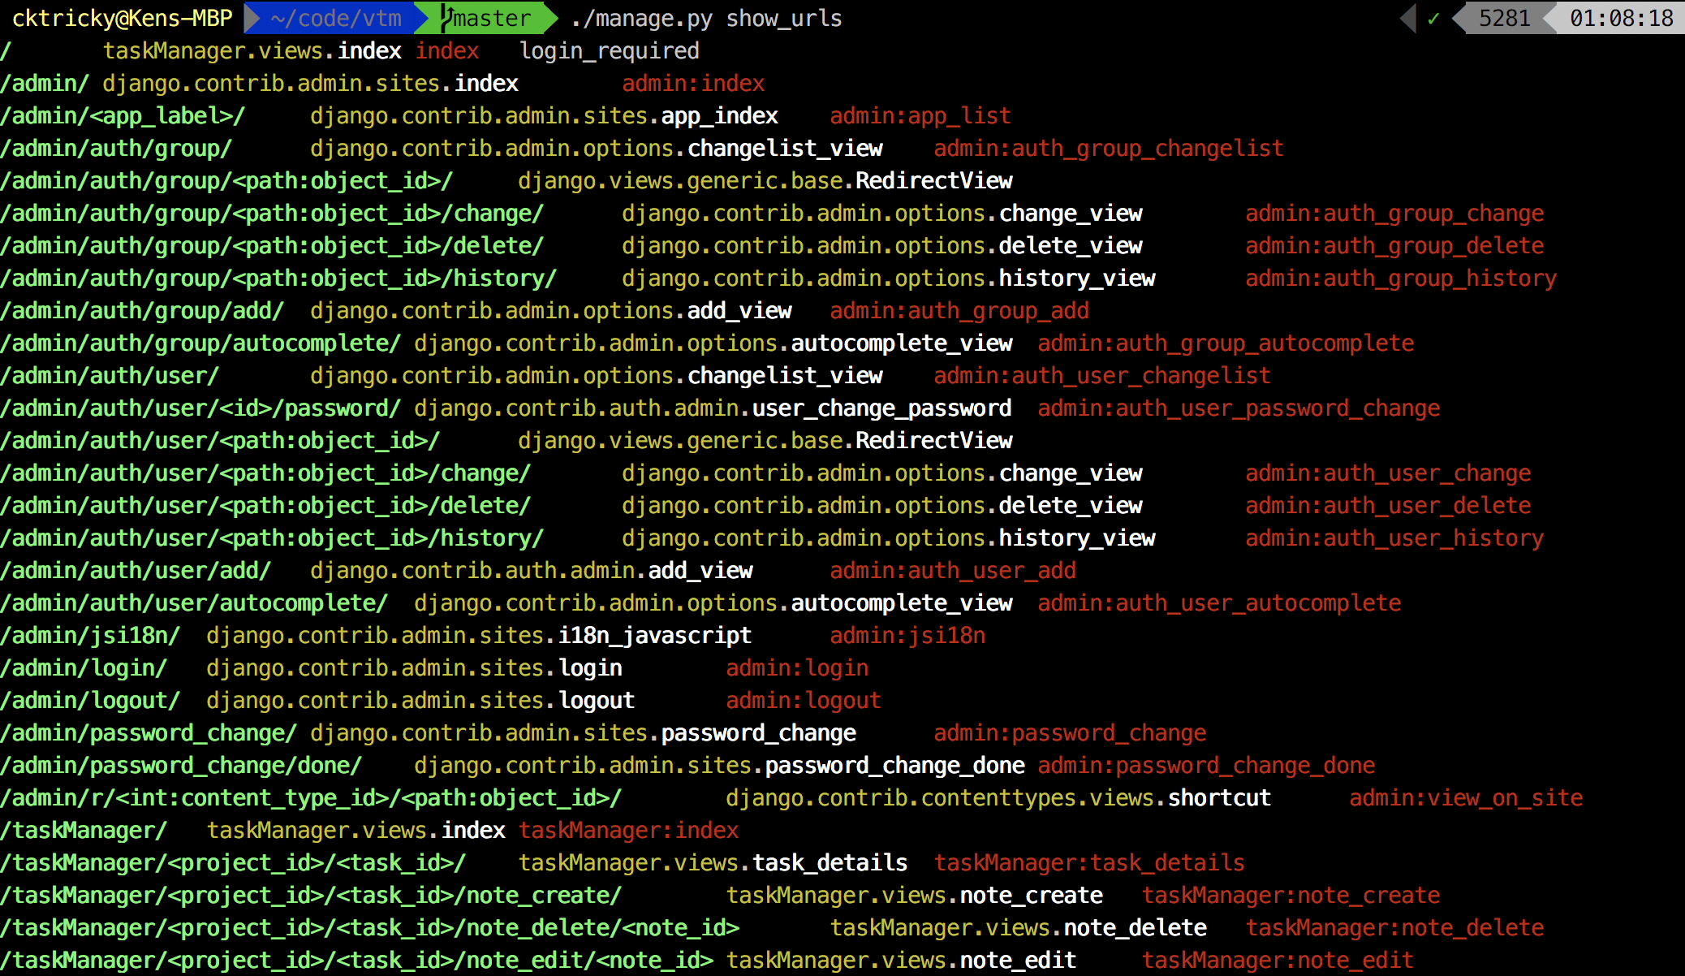
Django - Map

Slide 53
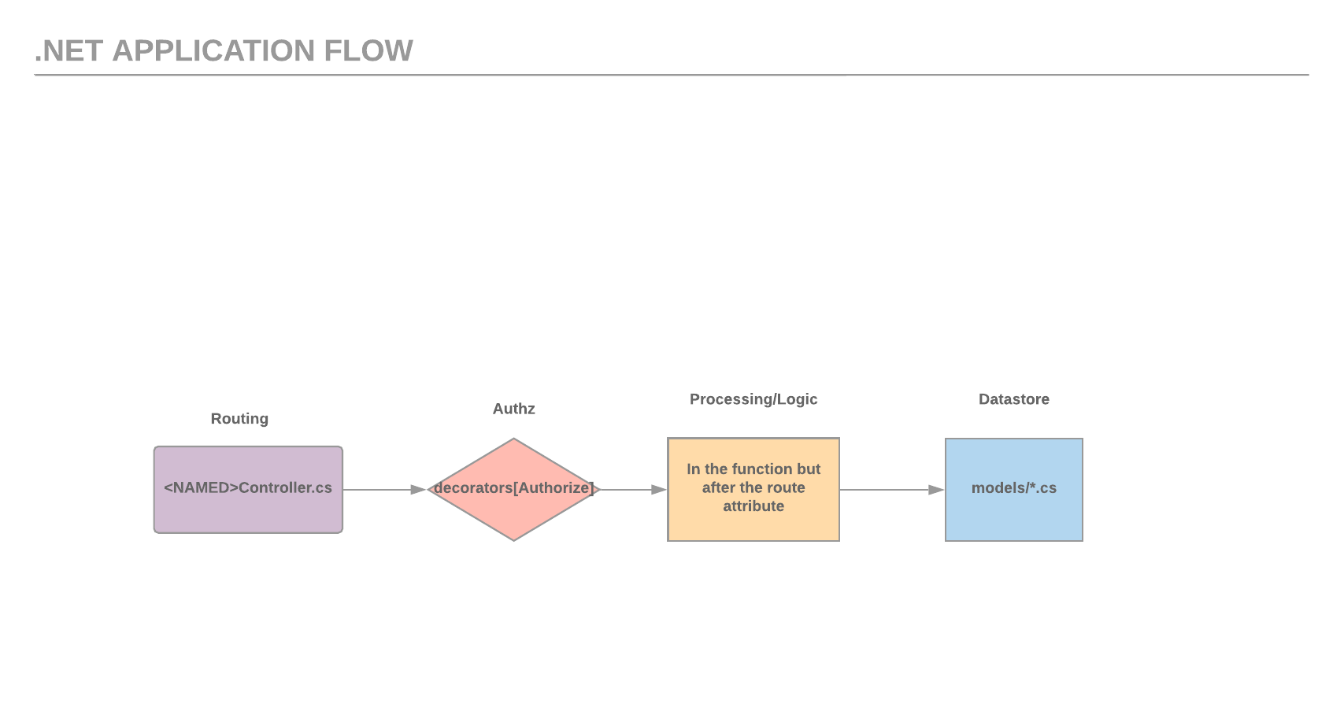

Slide 54
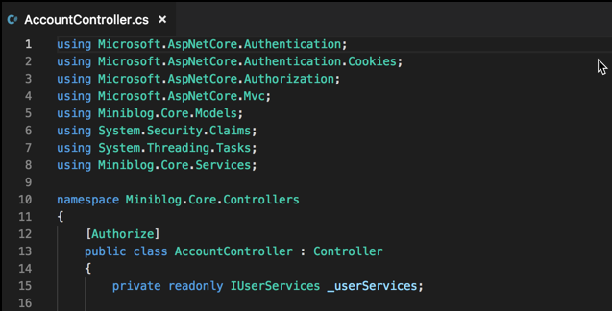
.NET Core - Map

Slide 55
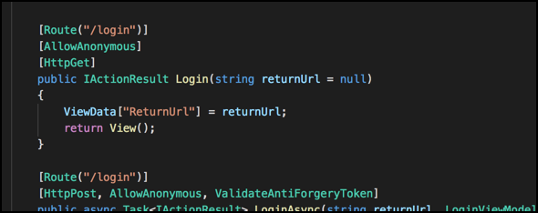
.NET Core - Map

Slide 56


Slide 57

Mapping
Exercise Rufus
What are the endpoints for the provided application?
Is that all of them?
Is there anything of note (security-wise)?

Slide 58
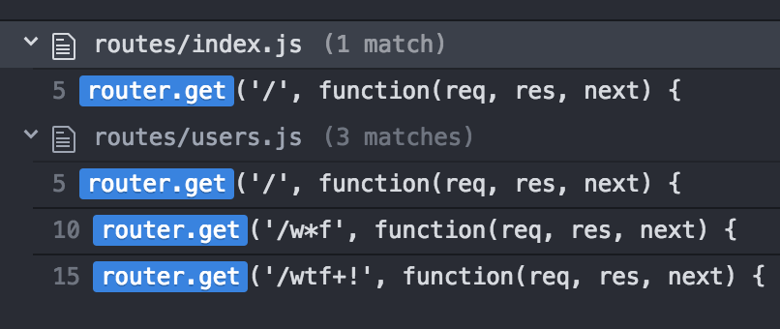
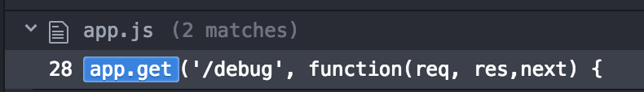
Rufus Exercise - Post-Mortem
Your notes should have
A commit #
The end points shown to the right
Any interesting things you may have found such as
The fact the auth function doesn’t do anything
The fact we have a Debug statement in our app and its printing env variables

Slide 59
Authorization Functions

Slide 60
Authz Functions
We’ve got a whole section dedicated to authorization
This is about getting to know the application a bit better
If we find a flaw, even better, but we just need to do this to understand things
Is there an exception to the rule? Sure.
incorrectly/missing filters
Incorrectly configured, for example...

Slide 61
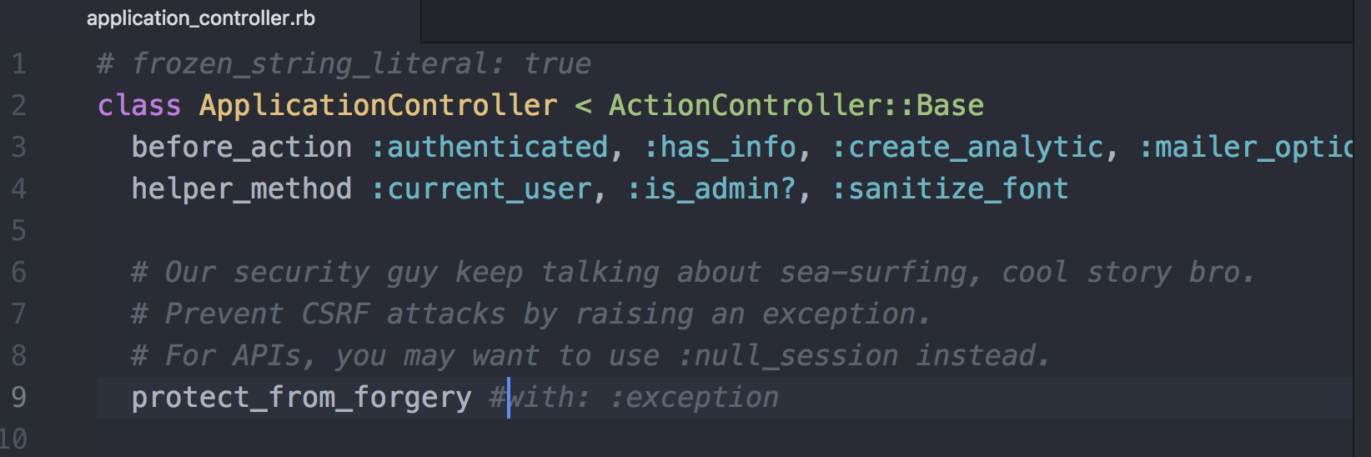
Authz Functions - Incorrectly Configured Example

Slide 62
Authz functions checklist
How are users identified
Session
Token
Basic Authentication
Something else?

Slide 63
Authz functions checklist
Identify its purpose
Is it just checking that we’re authenticated? - AuthN
Is it looking for a specific role? - RBAC
Is it doing some sort of HMAC verification for events?

Slide 64
Authz functions checklist
What could go wrong?
Insecure timing comparisons
Framework nuances
IDOR
Lack of rate limiting (see this often with basic auth or tokens)
Think about if it was *not* applied, what would happen
Get creative, you’re trying to decide what the risk, if any, is here

Slide 65

Authz Functions
Exercise Sigmund Freud
What authorization functions handle checks for skea_rails?

Slide 66
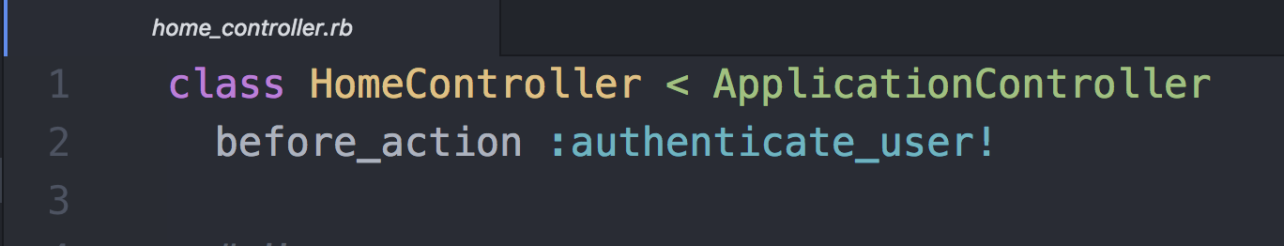
Sigmund Freud Exercise - Post-Mortem
Yeah, you probably have questions re: “authenticate_user!”
Which is why its part of the exercise :=D. THIS HAPPENS A LOT!
How to decipher where this action is defined will be defined by:
Access to an interactive runtime env?
Experience with the framework/libs?
No previous experience with it, only access to source?

Slide 67
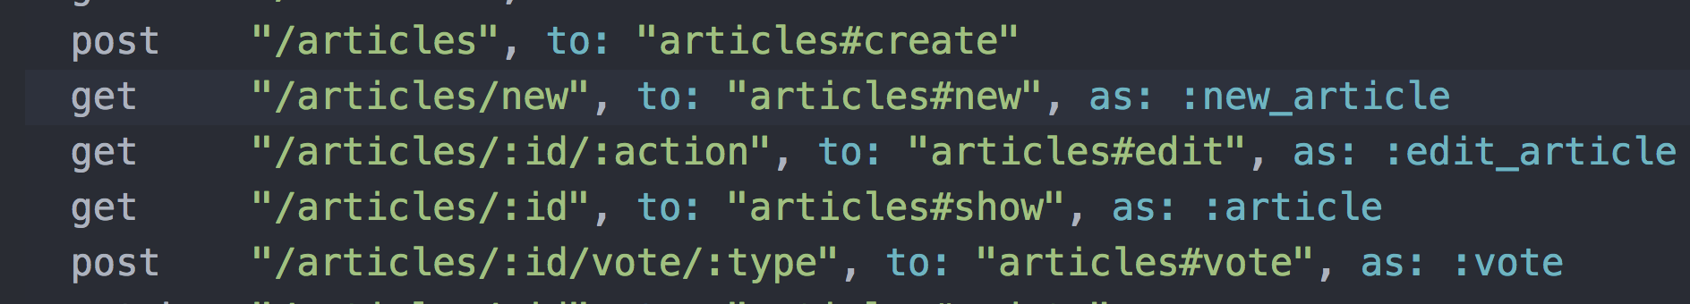
Sigmund Freud Exercise - Post-Mortem
Did you catch the CSRF? - “Framework Nuance”

Slide 68
Sigmund Freud Exercise - Post-Mortem
Anyone know what the request attack string would look like?

Slide 69

Sigmund Freud Exercise - Post-Mortem
So what’s the point with this whole thing?
You need to do your homework on framework nuances
Good example of why I often double-back and check one last time… (story time)

Slide 70
Authorization

Slide 71
Authorization Review
Analyze source for role enforcement, appropriate user boundaries, privileges required for access, and business-logic flaws
Roles and associated enforcement routines must be identified during information gathering
Pay attention to any endpoints that include sensitive data or functionality
Vertical authorization weaknesses - escalated privileges
Authenticated and unauthenticated access
Horizontal authorization weaknesses - access another user’s data

Slide 72
Authorization Review Vulnerabilities
Broken Access Control - OWASP Top 10 A5:2017
Privilege Escalation
Missing Function Level Access Control
Insecure Direct Object Reference
Sensitive Data Exposure - OWASP Top 10 A3:2017
Mass Assignment
Business Logic Flaws

Slide 73
Authorization Review Checklist
What are the different authorization functions?
Token/User/Role validation?
Is this handled by custom framework functionality?
Decorators vs. static source code
Can non-privileged users view, add, or alter accounts?
Is there functionality to add accounts with higher access levels than their own access?
How is separation of duties handled?
Are disabled accounts prevented from accessing content?
Can password-protected pages be directly accessed without authentication?

Slide 74
Mass-Assignment
Goes by a few names
Insecure Binder Vulnerability
Insecure Object Mapping
Mass-Assignment
Typically happens when a database entry is created or modified and we do so by throwing in *all* user-supplied parameters
For example...

Slide 75
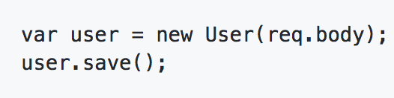
Mass-Assignment - Node

Slide 76
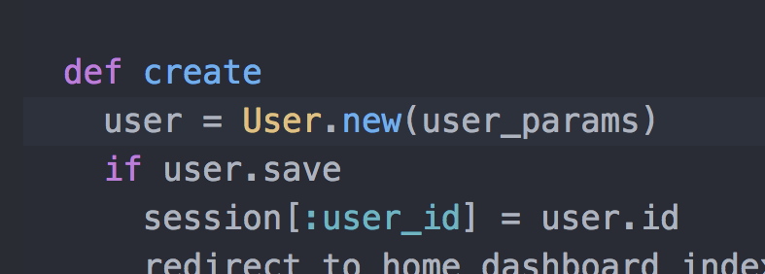
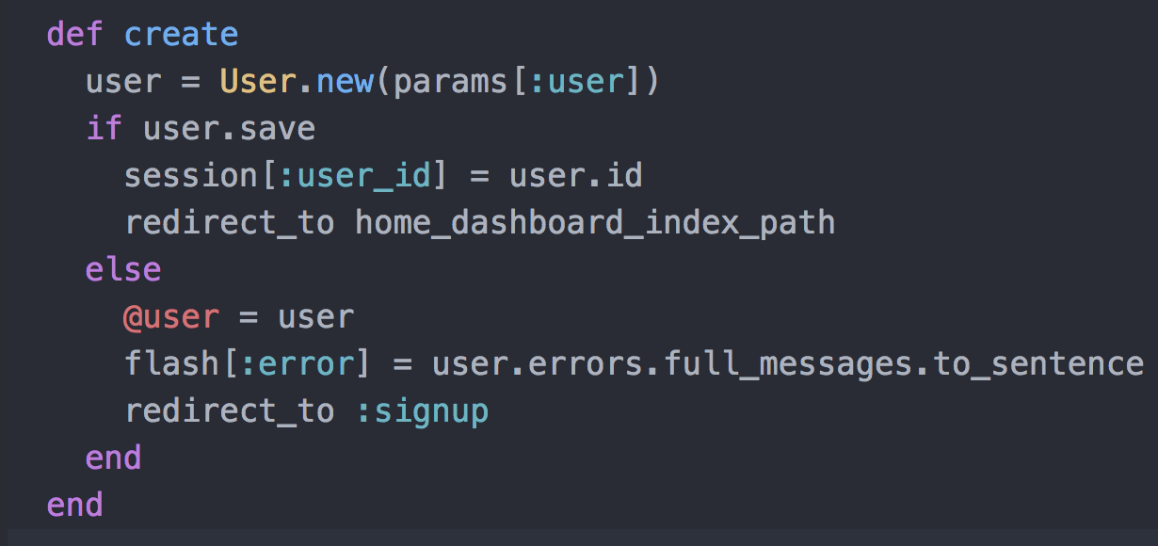
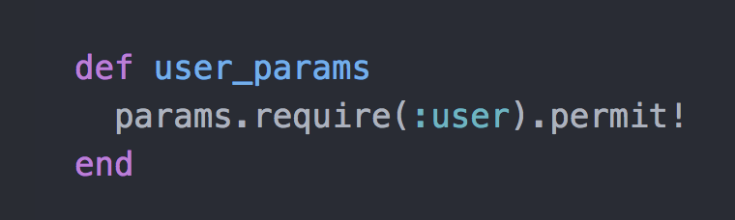
Mass-Assignment - Rails

Slide 77
Authorization Review Checklist
Is it possible to bypass authorization restrictions by accessing content directly (e.g. can a non-privileged user access the administration pages of an application)?
Can a user escalate privileges through cookie modification, altering form input values and HTTP headers, or by fuzzing URL-based parameters?
Are there horizontal escalation/Insecure Direct Object References in the source code?
Are authentication and authorization flows the first logic executed for each request?
Are authorization checks granular (page and directory level) or per-application?

Slide 78
Authorization Review Checklist
Are access to sensitive pages and data denied by default?
Are users forced to re-assert their credentials for requests that have critical side-effect (account changes, password reset, etc)?
Do authorization checks have clearly defined roles?
Can authorization be circumvented by parameter or cookie/token manipulation?
Are CSRF protections in place and appropriate?

Slide 79

Authorization
Exercise Genghis Khan
What skea_django authorization items are we concerned about?
Test access control checklist items.

Slide 80
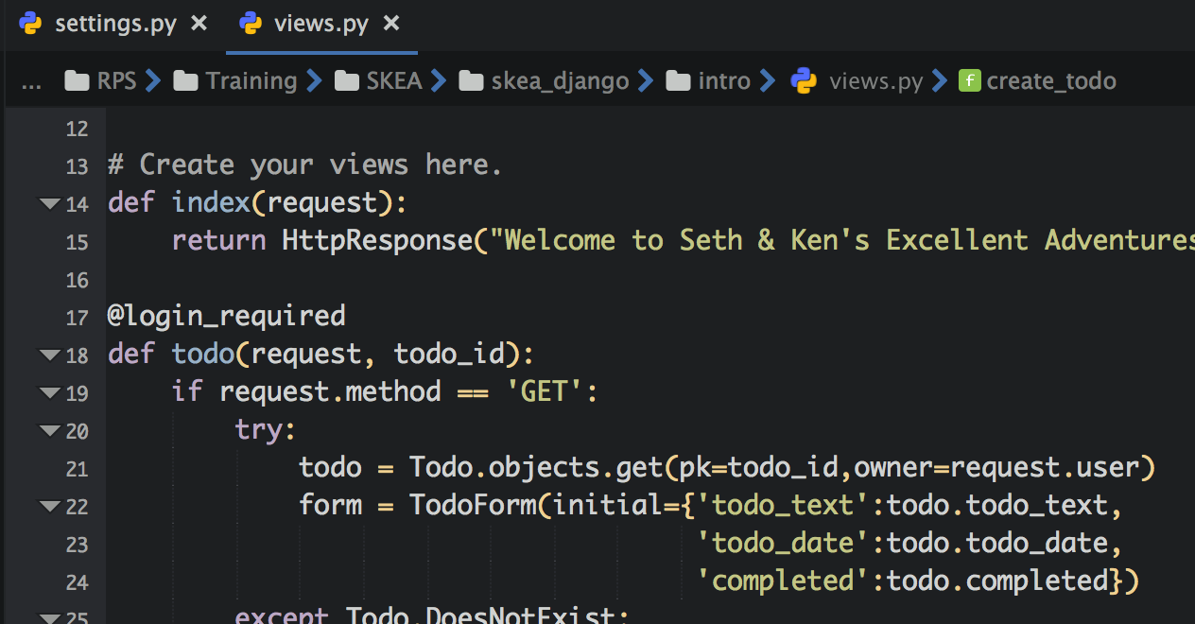
Genghis Khan Exercise - Post-Mortem
First of all look into views.py

Slide 81
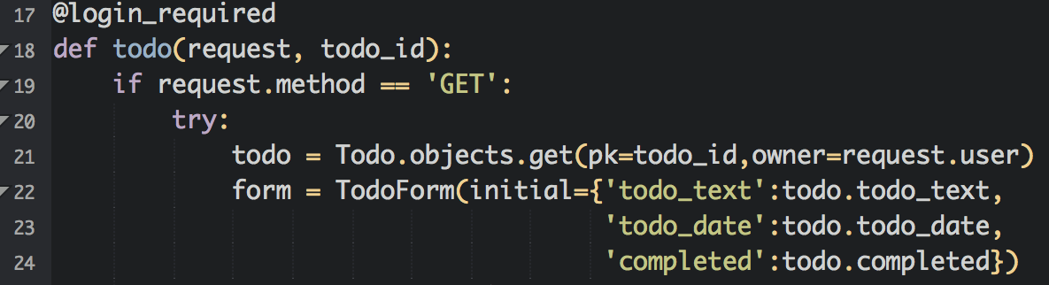
Genghis Khan Exercise - Post-Mortem
What about objects? Does it protect against IDOR? How?

Slide 82
Authentication

Slide 83
Authentication Review
Authentication establishes user identity
Examine the user identification process of the application.
Available application resources include both unidentified and identified users
Use enumeration of the application endpoints to trace the authentication flow and functions.
Sensitive application and business functionality should redirect as appropriate to the authentication flow to properly identify a user
Include an application functionality that identifies a user in this review

Slide 84
Authentication Review
How does an application confirm identity?

Slide 85
Authentication Review Vulnerabilities
Broken Authentication - OWASP Top 10 A2:2017
User Enumeration
Session Management Issues
Authentication Bypass
Brute-Force Attacks

Slide 86
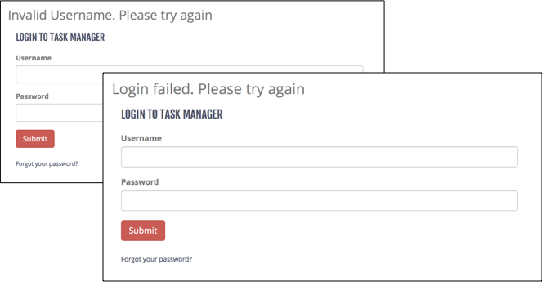
User Enumeration - Login Page

Slide 87
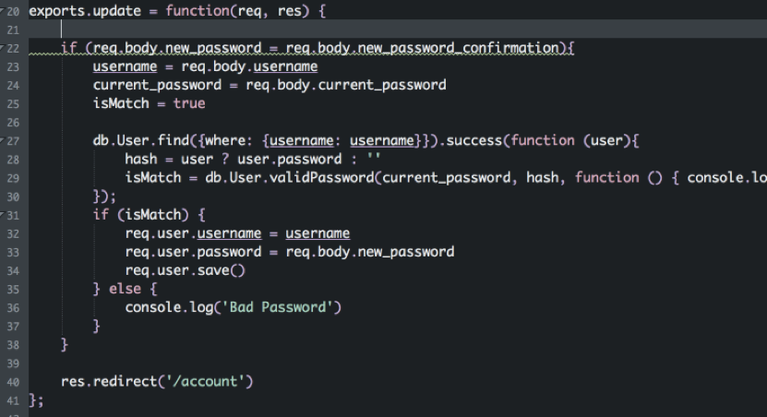
Broken Authentication - Node

Slide 88
Authentication Review Checklist
What are the different authentication flows?
User Login
User Registration
Forgot Password
How are users identified? What information do they have to provide?
Username, email, password, 2fa token, etc.
How is authentication handled on each application endpoint?
Sensitive endpoints should require authentication
Are there any hard-coded accounts?
Does application allow for easily-guessed, default, or common passwords?

Slide 89
Authentication Review Checklist
How are usernames determined, what naming conventions?
Does registration allow for easy enumeration?
Does the application allow for account enumeration through server responses or information disclosure?
login/registration/forgot password flows
Are user credentials protected in the data store using modern password hashing algorithms?
Are security policies are configurable via environment variables and not hard-coded?
What standard security frameworks are used?
Is there code specific to the application, especially when dealing with password storage?

Slide 90
Authentication Review Checklist
How are user management events such as authentication failures, password resets, password changes, account lockout and disabled accounts handled?
Are suspicious event handling such as multiple failed login attempts, session replay and attempted access to restricted resources handled properly?
Does the application implement strong password policies?
Are authentication credentials being passed using technologies that could be cached (HTTP GET, lack of proper cache-control settings)?
If applicable, are encryption mechanisms in place during authentication for secure communications (TLS, etc)?

Slide 91
Authentication Review Checklist (Registration)
Are limits on application access, such as geographical boundaries, enforced properly?
Is there a manual approval process or is access granted automatically?
Can the automated process be abused or bypassed using scripting or brute-forcing?
In cases where a validation email and link are required, how are the tokens generated?
Can users elevate their initial access via mass assignment or business-logic bypasses?
Are files and objects owned by a user removed or archived?

Slide 92
Authentication Review Checklist (Sessions)
Are encryption and hashing used properly?
Do encryption protocols use strong algorithms and industry-standard key lengths?
Are authentication tokens set with time limits?
Are cookies security parameters set properly (e.g. Secure, HTTPOnly, path)?
Are session IDs sent over a secure channel?
Are session IDs invalidated before a new login is made?
Are CSRF tokens set for all authentication requests?

Slide 93
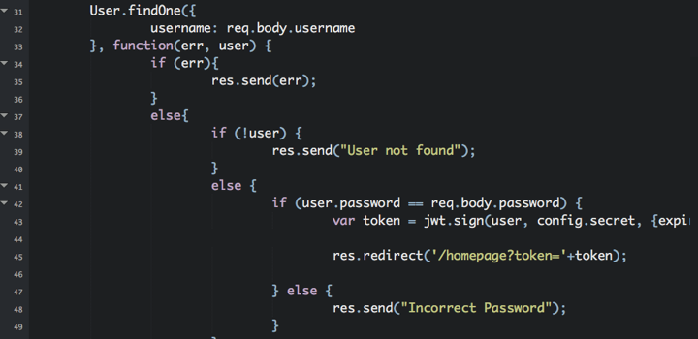
User Enumeration - Node

Slide 94
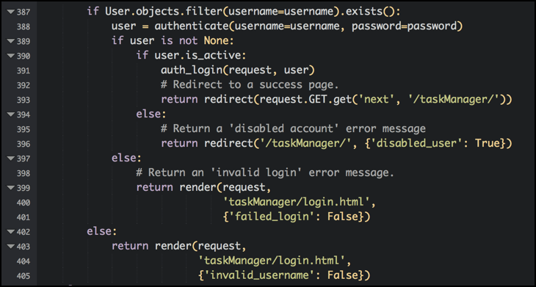
User Enumeration - Django

Slide 95
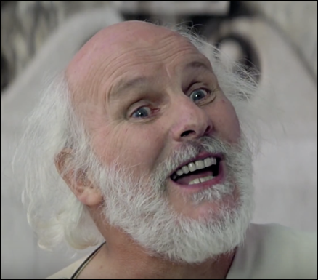
Authentication
Exercise Socrates
How are users identified in the provided application?
What checks should we be doing?

Slide 96
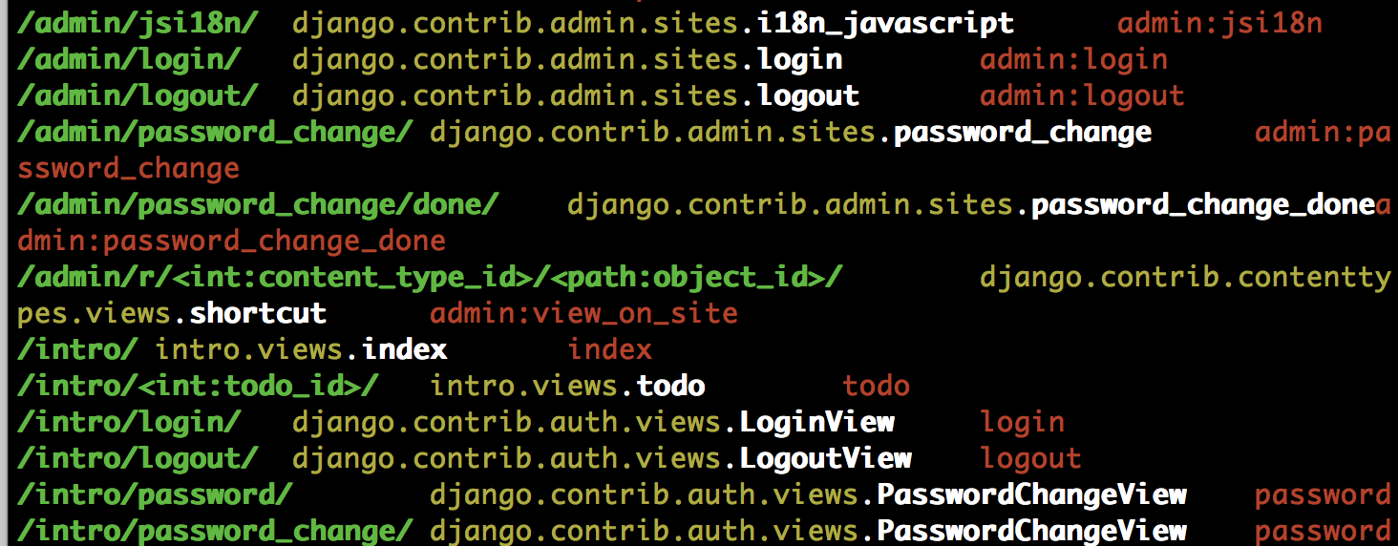
So-crates Exercise - Post-Mortem
So what exactly are we looking for?
./manage.py show_urls (django extensions have to be enabled).

Slide 97
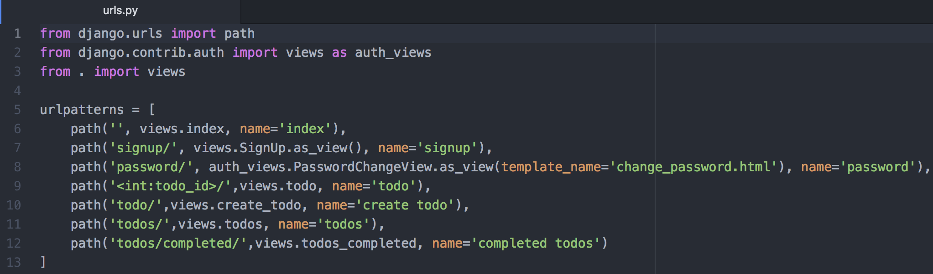
So-crates Exercise - Post-Mortem
Where do they go?
intro/urls.py has no references to login????

Slide 98
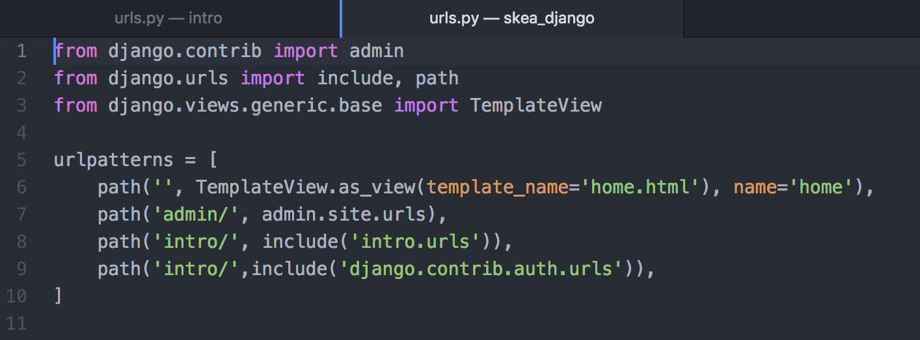
So-crates Exercise - Post-Mortem
Either does skea_django/urls.py - but there is a reference to django.contrib.auth.urls

Slide 99
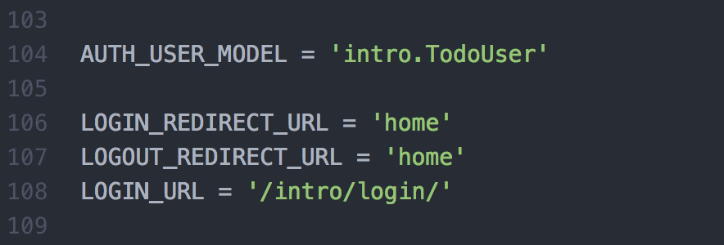
So-crates Exercise - Post-Mortem
Configuration documentation for django.contrib.auth leads us to skea_django/settings.py

Slide 100
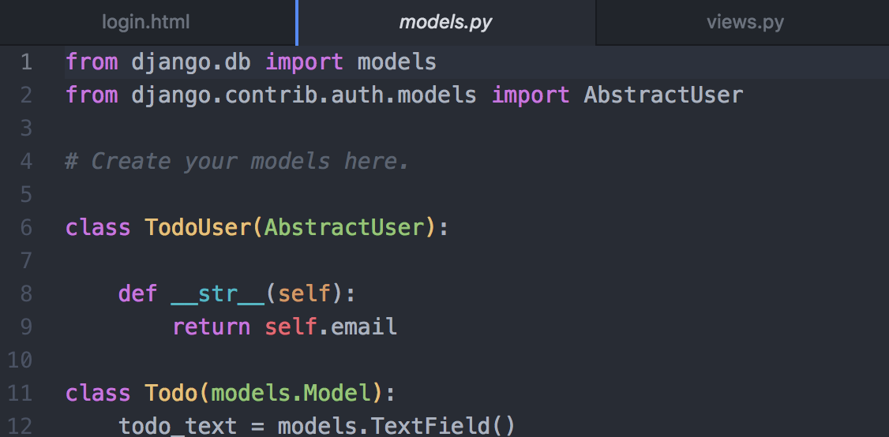
So-crates Exercise - Post-Mortem
Searching for django.contrib.auth leads us to intro/models.py

Slide 101
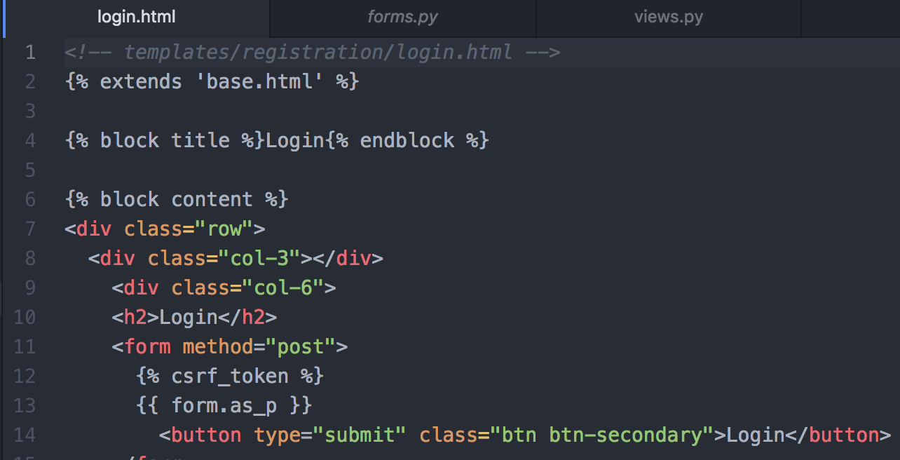
So-crates Exercise - Post-Mortem
If we go back to the django.contrib.auth documentation, it uses the templates in the registration directory.

Slide 102
Auditing

Slide 103
Auditing Review
Validate that appropriate logging and exception handling are handled within application source
One path in the trace of sensitive data from source to sink
Logging functions and error messages are considered a data sink
Logging should happen in any endpoint that performs a state-changing operation or has security implications
This data is used for immediate analysis and future forensics needs.
Check that sensitive data is appropriately handled (no credit card numbers, etc) and the correct details are logged
Administrators must trust that logs may not be manipulated by unauthorized parties

Slide 104
Auditing Review Vulnerabilities
Sensitive Data Exposure - OWASP Top 10 A3:2017
Insufficient Logging & Monitoring - OWASP Top 10 A10:2017
Debug Messages
Error Handling
Information Leakage

Slide 105
Auditing Review Checklist
If an exception occurs, does the application fails securely?
Do error messages reveal sensitive application or unnecessary execution details?
Are Component, framework, and system errors displayed to end user?
Does exception handling that occurs during security sensitive processes release resources safely and roll back any transactions?
Are relevant user details and system actions logged?
Is sensitive user input flagged, identified, protected, and not written to the logs?
Credit Card #s, Social Security Numbers, Passwords, PII, keys

Slide 106
Auditing Review Checklist
Are unexpected errors and inputs logged?
Multiple login attempts, invalid logins, unauthorized access attempts
Are log details should be specific enough to reconstruct events for audit purposes?
Are logging configuration settings configurable through settings or environment variables and not hard-coded into the source?
Is User-controlled data validated and/or sanitized before logging to prevent log injection?

Slide 107
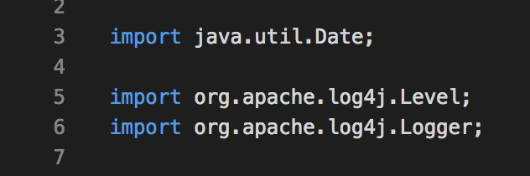
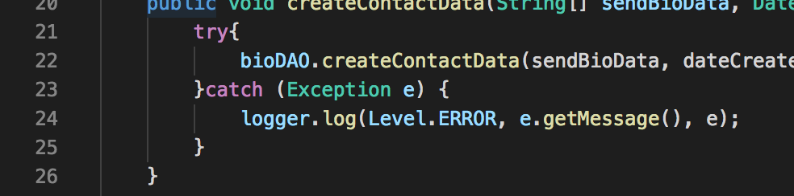
Logging - Java

Slide 108
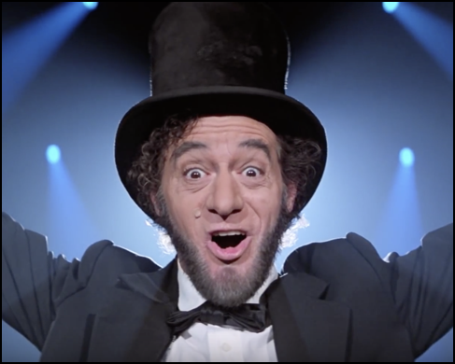
Auditing
Exercise Abraham Lincoln
Are logs enabled in the provided app? Where do they go? What’s in them?

Slide 109
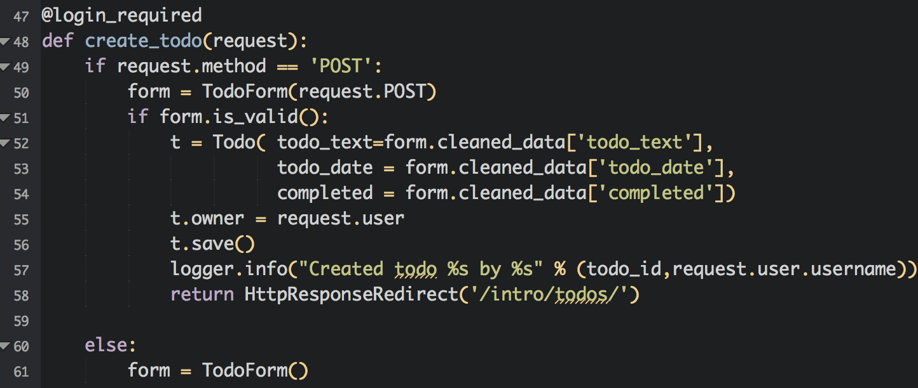
Abraham Lincoln Exercise - Post-Mortem
So where should we look? Sensitive functions.

Slide 110
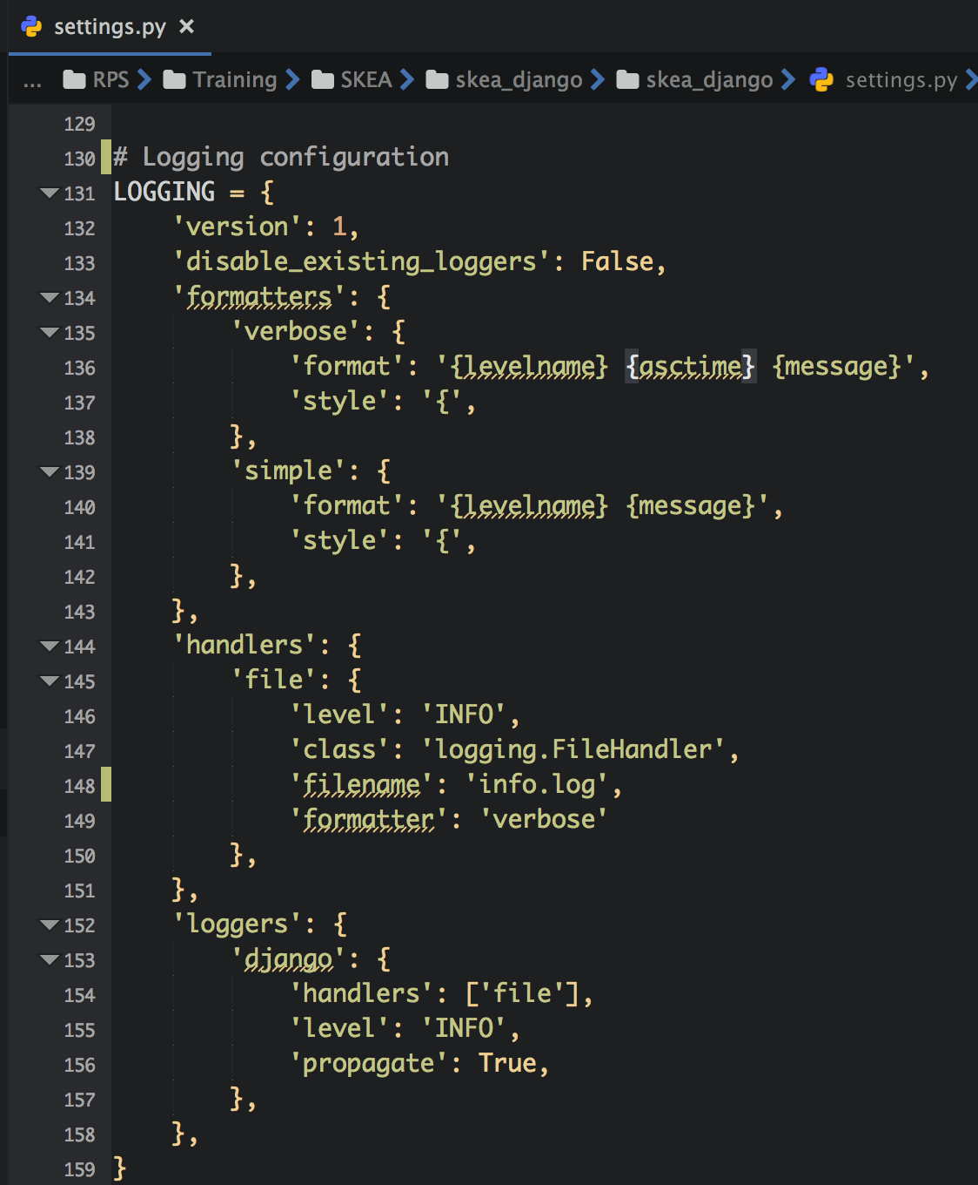
Abraham Lincoln Exercise - Post-Mortem
It’s django, so everything is setup in settings.py.
The intro application goes right along with this.

Slide 111
Injection

Slide 112
Injection
Causes:
Input Validation
Output Encoding
Types
SQL Injection
HTML Injection (XSS)
LDAP, XML, Command ...

Slide 113
Injection Vulnerabilities
Injection - OWASP Top 10 A1:2017
XML External Entities (XXE) - OWASP Top 10 A4:2017
Cross-Site Scripting (XSS) - OWASP Top 10 A7:2017
Redirects
SSRF

Slide 114
Input Validation
Analyze code that handles user input for type, format, and content validation before being used or stored by the application.
Compile list of data sources to work through.
Start with the routes identified in the information gathering phase, but also include:
Configuration files
Environment variables
External services
Database calls to external and internal databases.
...

Slide 115
Input Validation - Checklist
Is all input is validated without exception?
Do the validation routines check for known good characters and cast to the proper data type (integer, date, etc.)?
Is the user data validated on the client or server or both (security should not rely solely on client-side validations that may be bypassed)?
If both client-side and server-side data validation is taking place, are these validations consistent and synchronized?
Do string input validation use regular expressions?
Do these regular expressions use blacklists or whitelists?
What bypasses exist within the regular expressions?

Slide 116
Input Validation - Checklist
Does the application validate numeric input by type and reject unexpected input?
How does the application evaluate and process input length?
Is a strong separation enforced between data and commands (filtering out injection attacks)?
Is there separation between data and client-side scripts?
Is provided data checked for special characters before being passed to SQL, LDAP, XML, OS and third party services?
For web applications, are often forgotten HTTP request components, including HTTP headers (e.g. referrer) validated?

Slide 117
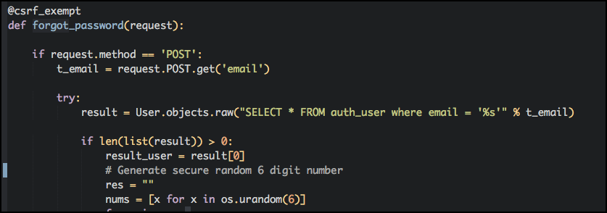
SQL Injection - Django

Slide 118

SQL Injection - Node.js

Slide 119
Output Encoding
Analyze code that sends user data to client for context, type, and format before sending to uncontrolled data sinks.
Start with a list of data sinks where data is being stored, sent, processed.
Source code libraries
3rd-party services
Storage components (database in any of its possible forms)
File system interactions
Log files
XSS, SSRF

Slide 120
Output Encoding - Checklist
Do databases interactions use parameterized queries?
Do input validation functions properly encode or sanitize data for the output context?
How do framework-provided database ORM functions used?
Does the source code use potentially-dangerous ORM functions? (.raw, etc)
What output encoding libraries are used?
Are output encoding libraries up-to-date and patched?
Is proper output encoding used for the context of each output location?
Are output encoding routines dependent on regular expressions? Are there any weaknesses or blind-spots in these expressions?

Slide 121

XSS - Node.js (ejs templates)

Slide 122

XSS - Django

Slide 123

Injection
Exercise Billy the Kid
Trace the source all the way to the sink

Slide 124

Exercise Billy the Kid - Post-Mortem
Some sources have already been identified. Are there others?
Configuration files, additional services, even databases.
Settings.py is somewhat trusted, but other people could manipulate data in the database before it gets to us.

Slide 125

Exercise Billy the Kid - Post-Mortem
Now for sinks, we know that the database file is one, but what else?
Anywhere data is /sent/ somewhere, file system, user, etc.

Slide 126

Exercise Billy the Kid - Post-Mortem
Search for user.username shows multiple references.

Slide 127

Exercise Billy the Kid - Post-Mortem
Diagram for user.username ends up looking like this.

Slide 128
Exercise Billy the Kid - Post-Mortem
This means we will be looking for the following injection flaws:
SQL Injection (database storage)
XSS (Stored/Reflected)
Log Forging/Injection

Slide 129
Cryptographic Analysis

Slide 130
Cryptographic Analysis
Analyze code for encryption flaws, outdated protocols, custom-developed algorithms, weak encryption, and misuse
Automated tools will uncover some of this, including
Use of older hashing algorithms (MD5, SHA-1, etc)
Code and routes that handles sensitive information specifically should be reviewed
API Tokens
Credit Card Numbers
Social Security Numbers
Customer Data
IDE Search for the following terms:
md5, sha1, base64, encrypt, decrypt, secure

Slide 131
Cryptographic Analysis Vulnerabilities
Lack of Encryption
Improper Encryption
Insecure Token Generation/Randomness

Slide 132
Cryptographic Analysis - Checklist
What are the standard encryption libraries are used for?
Hashing functions - password hashing, cryptographic signing, etc
Encryption functions - data storage, communications
Do the strength of implemented ciphers meet industry standards?
Less than 256-bit encryption
MD5/SHA1 for password hashing
Any RC4 stream ciphers
Certificates with less than 1024-bit length keys
All SSL protocol versions
Are cryptographic private keys, passwords, and secrets properly protected?

Slide 133

Cryptographic Analysis
Exercise Beeth-oven
How are passwords stored in the provided application? How are session tokens generated?

Slide 134

Exercise Beethoven - Post-Mortem
Sessions - Only indication we have of activity is settings.py

Slide 135

Exercise Beethoven - Post-Mortem
Sessions - Django documentation helps us out a little.

Slide 136

Exercise Beethoven - Post-Mortem
Sessions - but also gives us a warning...

Slide 137

Exercise Beethoven - Post-Mortem
Alright, so we should check the randomness of the SECRET_KEY
Looks random and secure, right? What are the concerns you have with this? Bueller?

Slide 138
Exercise Beethoven - Post-Mortem
Possible issues (outside of encryption routines):
Hardcoded values stored in source
Same key used for dev/staging/production

Slide 139

Exercise Beethoven - Post-Mortem
Password Storage? Nothing in settings.py?

Slide 140

Exercise Beethoven - Post-Mortem
PASSWORD_HASHERS in settings.py

Slide 141

Exercise Beethoven - Post-Mortem
Did you run the app?

Slide 142
Configuration Review

Slide 143
Configuration Review
Analyze any configurations included for security flaws
Includes language, framework, and server configurations
Highly specific to the targeted language/framework
Consult the server/framework documentation for guides on security flags and settings.
Examples:
Administrative Functionality enabled through configuration files
CSRF settings
Cookie parameters

Slide 144
Configuration Review Vulnerabilities
Security Misconfiguration - OWASP Top 10 A6:2017
Insecure defaults
Incomplete configurations
Open cloud storage
Using Components with Known Vulnerabilities - OWASP Top 10 A9:2017
Any dependencies, libraries, services

Slide 145
Configuration Review - Checklist
Are any endpoints enabled through configurations properly protected with authentication and authorization?
Are security protections implemented in framework properly configured?
Does the target language and framework version have any known security issues?
Are configuration-controlled security headers implemented according to recommended best practices?

Slide 146

Security Misconfiguration - Java Spring

Slide 147
Additional Resources

Slide 148
Additional Resources
OWASP Code Review Guide - Includes some language-specific best practices for Java, .Net, C, C++.
Simplicable Secure Code Review Checklist
Infosec Institute - Secure Code Review: A Practical Approach
OWASP Input Validation Cheatsheet
OWASP XSS Prevention Cheatsheet
Recommended headers for internal and external Web User Interfaces
Wikipedia - Principle of Layered Security
Wikipedia - Principle of Least Privilege
OWASP ASVS (Application Security Verification Standard)

Slide 149
Reporting and Retesting

Slide 150
Reporting and Retesting
This phase of the methodology is probably the most important.
Document findings in a manner that can be understood by a developer.
Review the source after remediation using the same techniques (rinse & repeat).
THIS IS THE WHOLE POINT.

Slide 151
Report Writing (or ticket creation)
Detailed findings include:
Description
Applicable File, Function, Variables, Line Numbers
Risk Severity
Likelihood of Exploitation
Ease of Exploitation
Remediation Approach
References

Slide 152
Party On, Dude

Slide 153
Ken - cktricky@gmail.com
Seth - seth@redpointsecurity.com

